Slide 1
LESSON BLOCK 1
COMMUNITY

Slide 2
LISTENING
Subtitle goes here if you need it

Slide 3
How do you listen to music?
Where do you listen to music?
When do you listen to music with other people?
How does it feel?

Slide 4
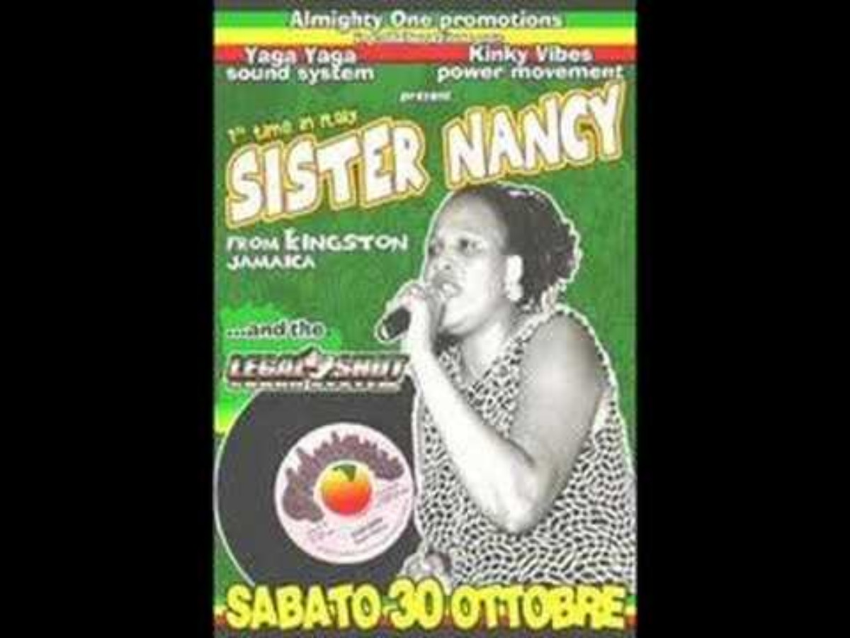
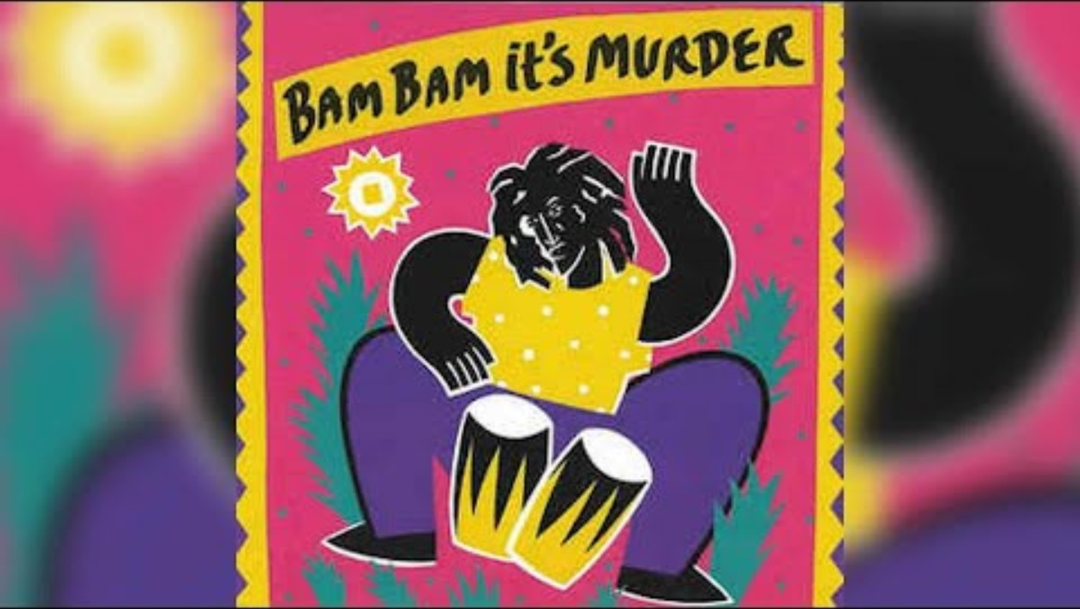
Listen to these two songs, then reflect.
Bam Bam
by Sister Nancy
Techniques Records, 1982
Bam Bam
by Chaka Demus & Pliers
Mango, 1992

Slide 5
Does this sound familiar to anyone?
Even if you don’t recognize the song does the rhythm or texture remind you something you do know?
When do you think a song like this might play?

Slide 6
LOOKING
Subtitle goes here if you need it

Slide 7
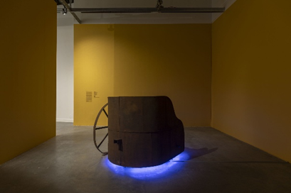
Michael Richards, Swing Lo’, 1996
Michael Richards (b. 1963, New York, NY; d. 2001, New York)
Swing Lo’, 1996
Steel, neon, wood, speakers with musical soundtrack, audio tape
The Michael Richards Estate
Photo by Oriol Tarridas Photography

Slide 8
Has anyone seen anything that looks like this before?
Does it look old or new?
Where would you expect to see it?
What kind of sound would you expect it to make?

Slide 9
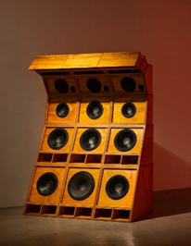
Cosmo Whyte, Sole Imperial, 1996
Cosmo Whyte (b. 1982, St. Andrew, Jamaica; lives in Los Angeles, CA)
Sole Imperial, 2019
Plywood, 12 speakers, 3 horns, 15 tweeters
Courtesy of the artist and Anat Ebgi Gallery

Slide 10
Do you see any similarities between this sculpture and Swing Lo’?
How is it different?
Where would you see an object like this? What kind of music or audio do you think this stereo system plays?

Slide 11
“Dancehall’s roots began and were informed by the lived experience of Kingston’s lower and working class people. The music that came out of it was melodic narratives on how they navigated the space, but dancehall is as much about music as it is about the fashion, dance and art that surrounded it. It wasn’t just a genre, it was a way of life.
Prior to dancehall’s proliferation, ska, rocksteady, mento, American R&B and roots Reggae were the styles of music that were most prominent across Jamaica, but in the late ’70s, a shift began with both the sound and lyrical content that then-emerging artists were crafting. Soundsystems and dance halls —physical areas designated for partying — were already fixtures in various communities in and around Kingston. Surrounded by food, alcohol and budding dancehall aficionados, a deejay would toast, or rather, speak over, a vinyl record, and sound clashes — competition between opposing local Soundsystems — started to increase in popularity. As such, dancehall continued to grow and became a favorite amongst the masses, as everyday experiences and shared longing for a different life were transcribed into infectious and rhythmic musical arrangements.”
Sharine Taylor in “The Essential Guide to Dancehall.”

Slide 12
Think about a time you have gathered with others around music in a public or communal space (like a block party, a concert, a crowded bus, a locker room, or even online). What role did the music play in shaping attitudes in that space or bringing people together?
The sound system in Jamaican communities served as a space where many people, often marginalized, could define themselves and assert their power. Have you ever been in a communal space where the music, fashion, or atmosphere made you feel more visible, respected, or most like yourself?
People sometimes refer to attending a dancehall event as “going to church.” Why might a loud dance party be described using spiritual or religious language?
The spiritual song “Swing Low, Sweet Chariot” sings of redemption and ascension. How does music function as a tool for hope or survival for your communities, even when facing issues like economic hardship or oppression?

Slide 13
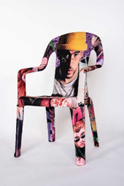
Edra Soto, BB Chair 1, 2025
Edra Soto (b. 1971 location, Puerto Rico; lives in Chicago Illinois)
BB Chair 1, 2025
Textile and plastic
Courtesy of Engage Projects

Slide 14
What is familiar about the shape and material of these chairs? Where have you seen chairs like this before?
How has the artist transformed this everyday object?
If Michael Richards and Cosmo Whyte focused on monumental sound systems, how does Edra Soto’s work, focused on seating, contribute to the idea of gathering and community?
What feeling or tone do the colors, fabrics, and decorative elements (like the airbrushed names) convey?

Slide 15
If the sound system (seen in the works of Richards and Whyte) created community through powerful sound, how do these chairs create community?
Bad Bunny uses his artistic platform to celebrate aspects of Puerto Rican life. How can popular culture validate objects and spaces that have been overlooked or deemed “low-class”?

Slide 16
MAKING

Slide 17
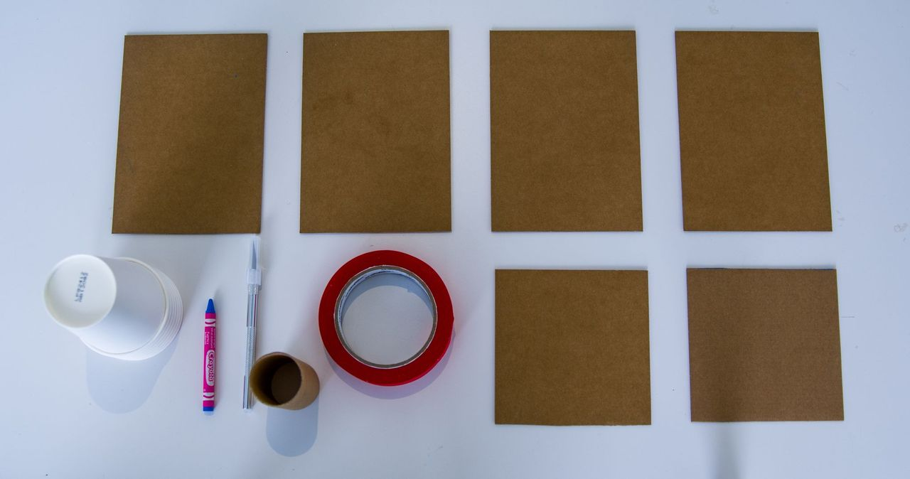
GET LOUD
Paper amplifiers
Gather materials: cardboard, disposable cup, paper towel roll or toilet paper roll, craft knife, pencil, ruler, masking tape or hot glue, decorative materials

Slide 18
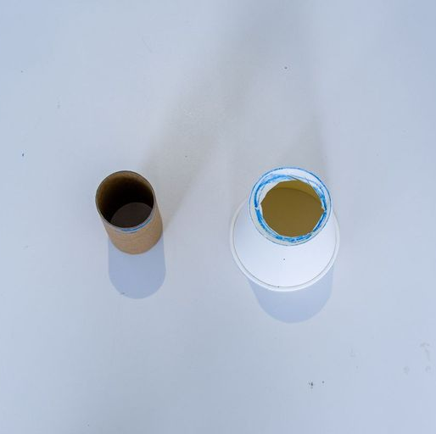
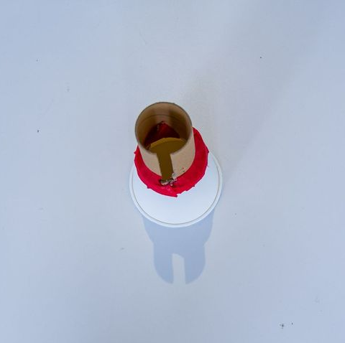
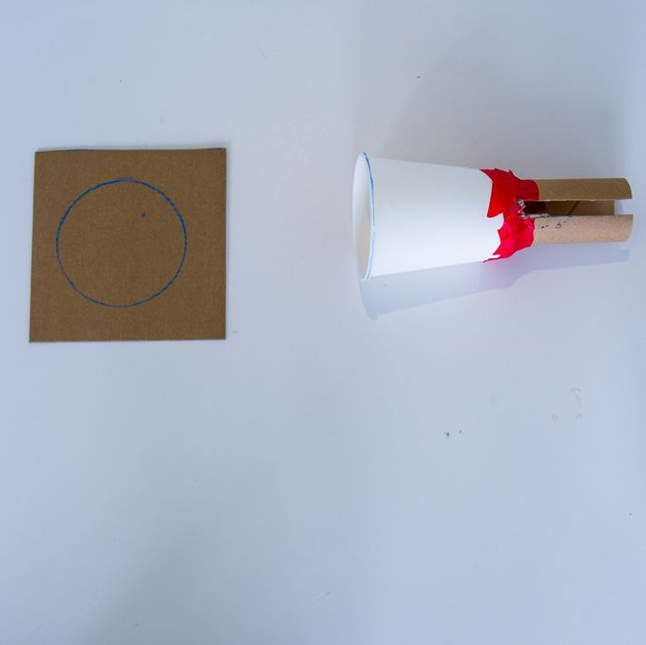
GET LOUD
Paper amplifiers
Cut the bottom off the cup to create a sort of funnel using the craft knife. This will be the “speaker”.
Secure the paper towel roll onto the narrow end of the cup roll using tape or hot glue
Trace the opening of the cup onto one of the cardboard square end pieces.

Slide 19
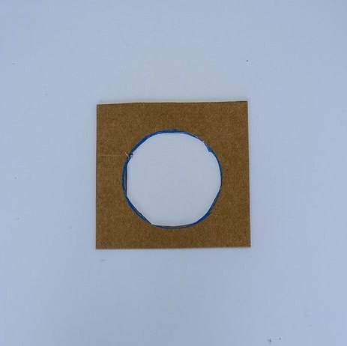
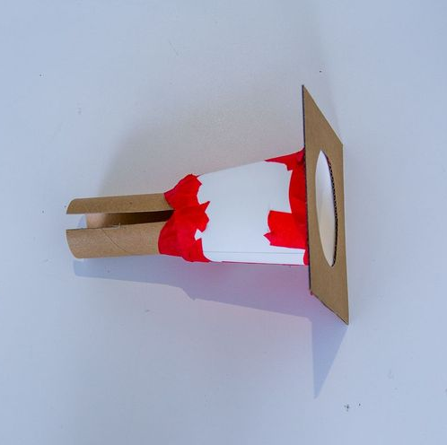
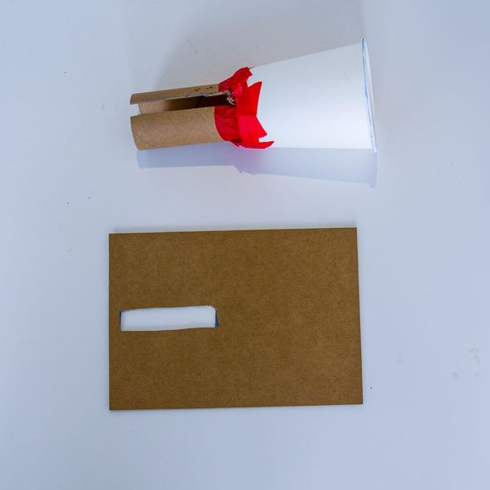
GET LOUD
Paper amplifiers
Cut out the circle to create an opening.
Secure the cardboard onto the opening of the cup. Refer to the image for how it should look.
Cut a slit the size of the bottom of a cell phone into the top of the cardboard tube.

Slide 20
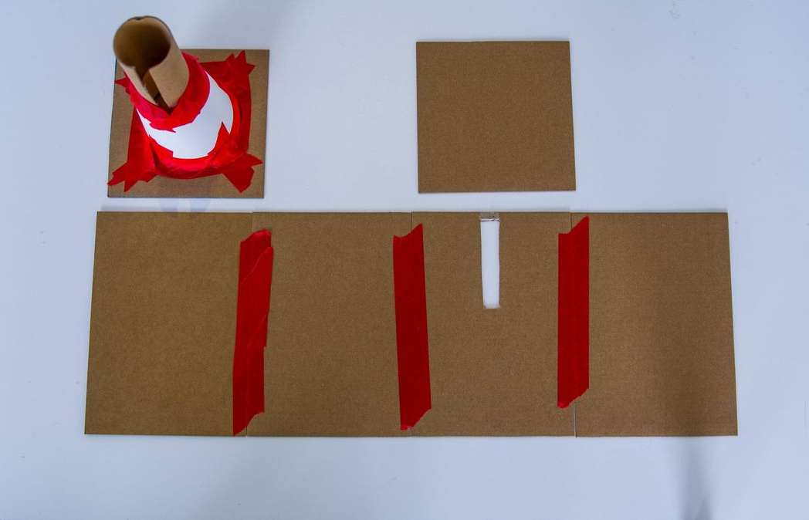
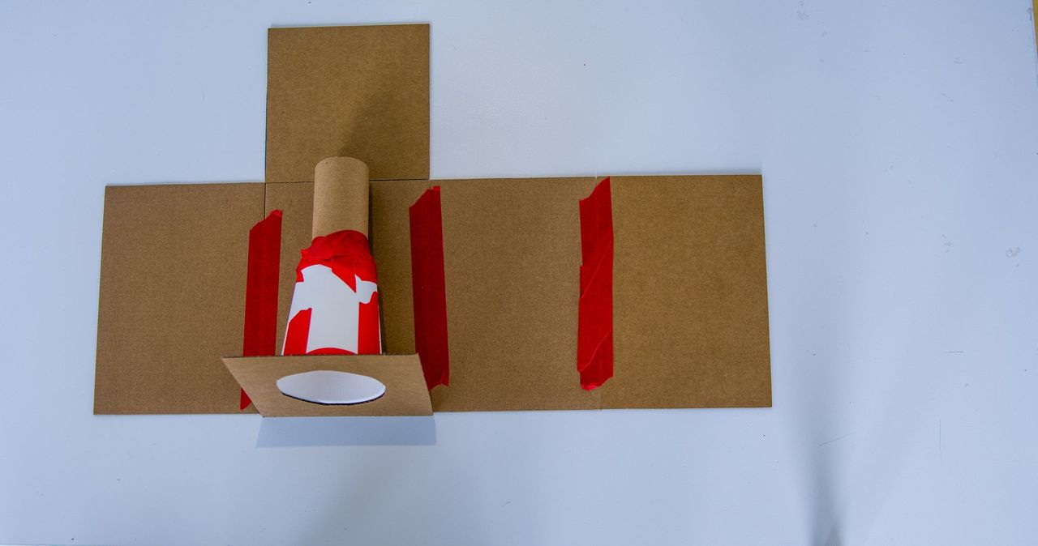
GET LOUD
Paper amplifiers
Tape or glue the carboard pieces into a box around the amplifier leaving the top piece for last.
Before attaching the top of the box, cut a slit in the top piece of cardboard that is the same location and size as the slit in the paper towel roll.

Slide 21
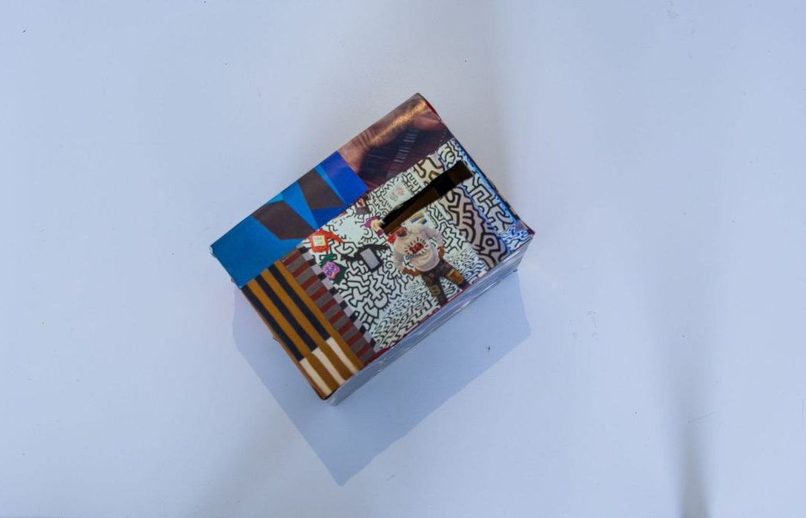
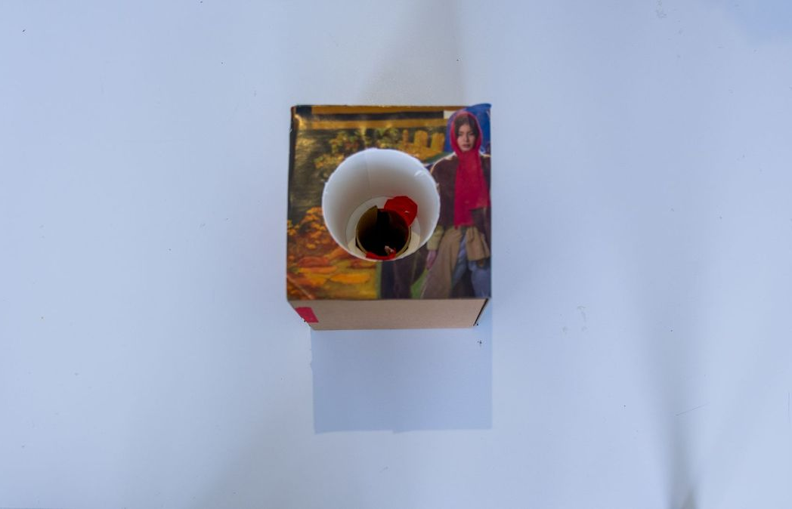
GET LOUD
Paper amplifiers
Decorate the exterior of the amplifier to draw people to gather around the “sound system”.
Once the amplifiers are constructed and decorated, play music on a cell phone, insert the phone into the slot on the top of the amplifier and get loud.

Slide 22
LESSON BLOCK 2
CONGREGATION

Slide 23
LISTENING
Subtitle goes here if you need it

Slide 24
How do you listen to music?
Where do you listen to music?
When do you listen to music with other people?
How does it feel?

Slide 25
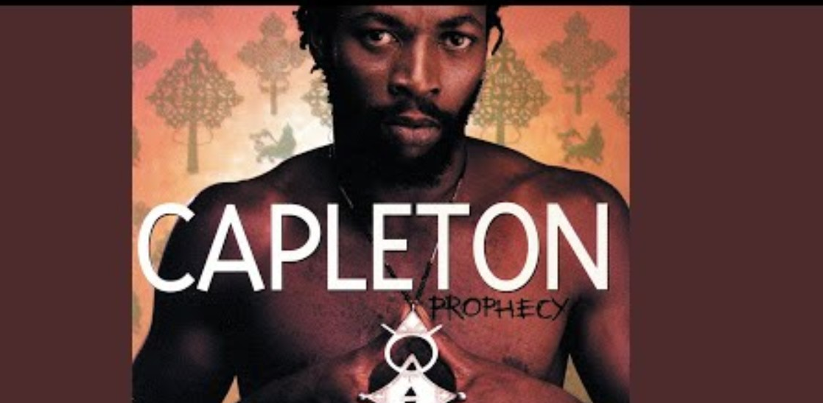
Listen and reflect on the questions on the next slide.
Tour
by Capleton
1994

Slide 26
Write about a time you were in community. Where did you meet?
What did you do together?
How did it feel to spend time together?
How often do you get together with people in that way?

Slide 27
“Capleton's "Tour" is a classic dancehall track about his actual experiences and observations while on the road, highlighting real-life events, political commentary, and spiritual messages of purification (fire), reflecting his Rastafari faith, and his lyrical style involves prophetic warnings and praise for Jah.

Slide 28
Do you hear spiritual themes in this song? Where?
This song is political, spiritual, and personal. Can you think of other music that encompasses multiple themes?

Slide 29
LOOKING
Subtitle goes here if you need it

Slide 30
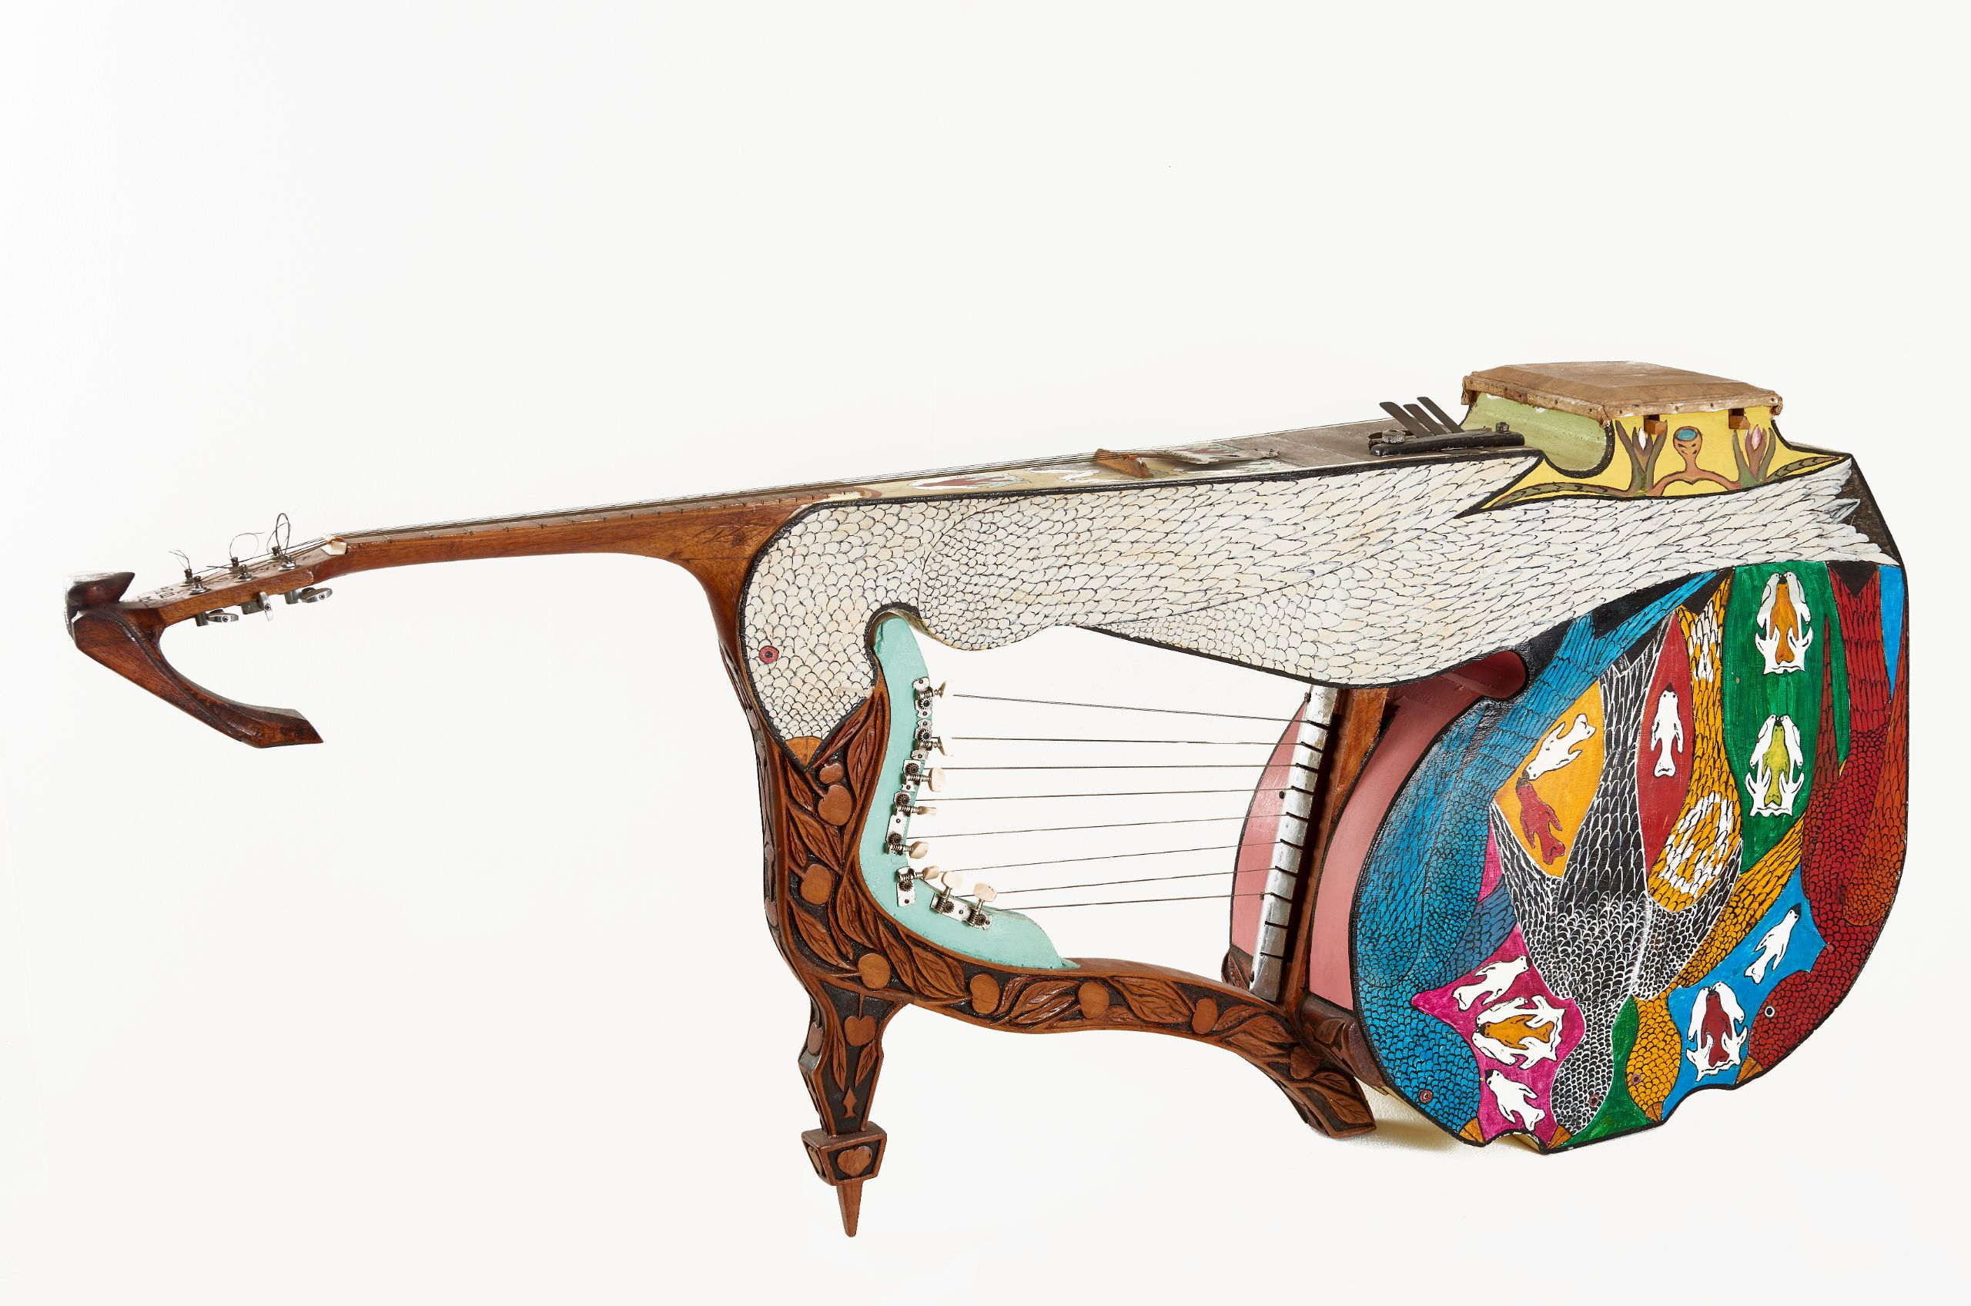
Everald Brown, Starry Harp (Instrument for Four People), 1986
Everald Brown
(b. 1917, Clarendon, Jamaica; d. 2003, New York, New York)
Starry Harp (Instrument for Four People), 1986
Oil paint on wood.
National Gallery of Jamaica.

Slide 31
Have you ever played an instrument? What did it look like?
Does this instrument remind you of anything you have ever seen before?
How many people do you think can play this instrument at one time?
How would they have to arrange (sit, stand, crouch, reach) together to play this instrument together? What kind of music would it make?
What do you notice about how this instrument is decorated? What kinds of symbols do you see?

Slide 32
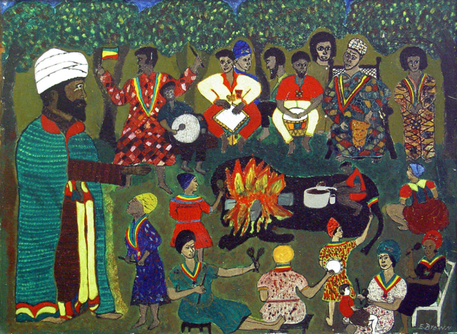
Everald Brown, Nyabingi Hour, 1969
Everald Brown
(b. 1917, Clarendon, Jamaica; d. 2003, New York, New York)
Nyabingi Hour, 1969
Oil on hardboard
National Gallery of Jamaica

Slide 33
What kinds of things are the people in the painting doing? How are people interacting?
Do you recognize any patterns or symbols?

Slide 34
“Yet, through my exploration of bodies and theologies in the African diaspora, I have come to realize that these two kinds of bodies and rituals are perhaps engaged in not entirely dissimilar conversations. Both bodies are engaged in intimate meaning-making processes…
…As much as orthodox Reggae music can be characterized as a form of spiritual enlightenment, dancehall music comprises a spiritual element as well. The practitioners of dancehall do not simply perform lewd and lascivious acts, neither do they simply sing or deejay (rap) about immorality as a mere pastime, but they in fact garner a sense of belonging and control over their lives and destinies through the art form. Dancehall is influenced by Jamaica’s religious landscape, which is suffused with Christianity, African-derived beliefs and practices, and Rastafari. These influences, which are integral to the Jamaican nomos, help to shape the dancehall subculture. Dancehall, however, refashions the given order and produces its own moral codes, ritual practices, and ways to achieve enlightenment through the modification of normative Christian and Rastafarian ideologies, as well as unique elements produced from life experiences in the ghettoes of Jamaica. Dancehall is an intimate form of musical and embodied communication (perhaps too intimate for the Jamaican Christian majority) and through movement, “riddims,” and lyrics, dancehall lovers and those living in the “garrison” (inner city) where dancehall gets its soul, fellowship together and feed their spirits.”
The Spirit of Dancehall: Embodying a New Nomos in Jamaica by Kythie K. Brown

Slide 35
People gather around the Starry Harp and perform a groundation for a religious or spiritual reason. Communities gather around a sound system for a party. On the surface, these are very different occasions.
How are they similar, beyond being opportunities for congregation?

Slide 36
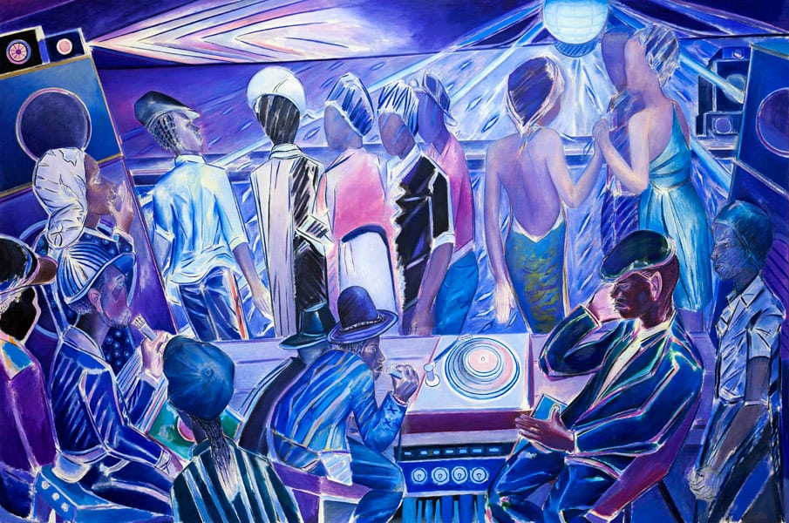
Denzil Forrester, Duppy Deh, 2018
Denzil Forrester (b. 1956, Grenada; lives in Cornwall, United Kingdom)
Duppy Deh, 2018
Oil on linen
Courtesy of Margot and George Greig

Slide 37
What kinds of actions or movements do you see occurring in this painting?
How does the artist use color, shapes, and angles to convey the feeling of the space?
If this is a nightclub, how does it feel similar to or different from the gatherings depicted in Everald Brown’s work, Nyabinghi Hour?
How do you imagine the music sounding in this moment? How does the painting capture the intense sound and rhythm?

Slide 38
Everald Brown’s ceremonies and the music of Roots Reggae enabled collective resistance against injustice. Forrester depicts the subsequent generation's equivalent gathering space: the club. For Brown, music served as a call to consciousness for social justice and spiritual fulfillment. For Forrester, Dub and Reggae provided a psychological and spiritual space for the diasporic community to assert power and identity away from colonial oppression and racial tension.

Slide 39
How are the concepts of resistance and liberation expressed differently when gathering in a religious ceremony versus gathering in a dance club?
How might the ecstatic movement and loud volume of a dancehall club function as a temporary spiritual ascent for the participants, similar to traditional rituals?
Forrester captured the energetic flow and rhythm of the club by drawing for the length of a single track. How does this method suggest that rhythm and sound are fundamental to shaping the communal and spiritual space?

Slide 40
MAKING

Slide 41
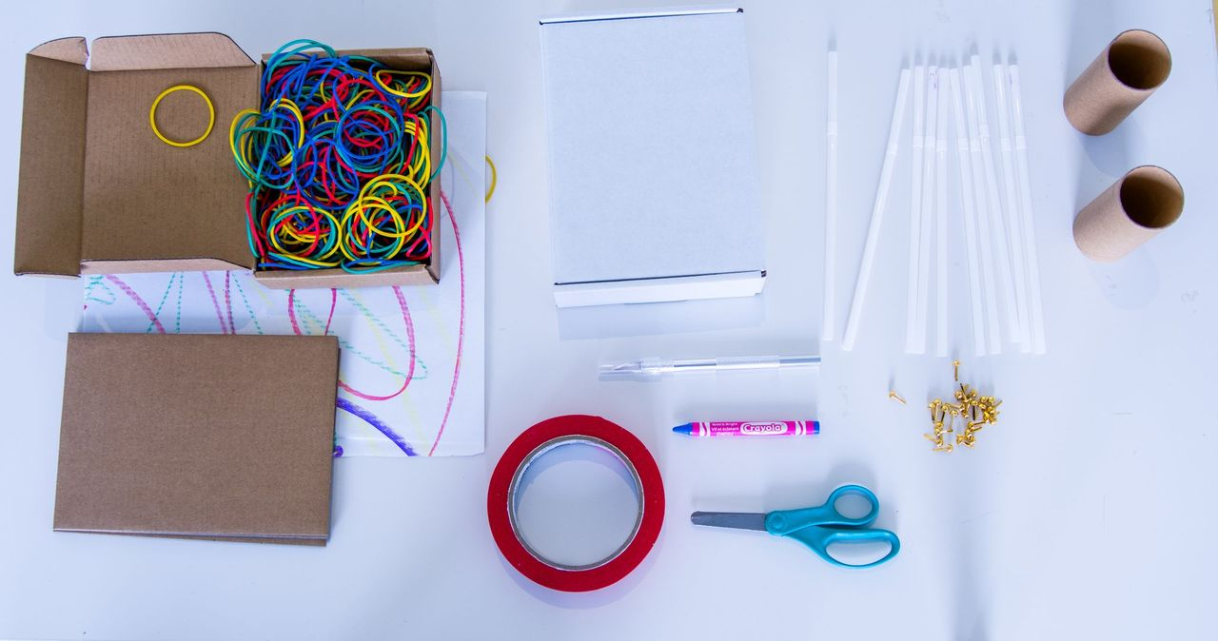
GET LOUD
Paper amplifiers
Gather materials: Decorated paper from Lesson Block 1 Gathering Activity, Found Objects (Cereal Boxes, Toilet Paper Rolls, Cardboard, Rice, Beads, Etc.), Straws, Rubber Bands, Fasteners and Masking Tape, Colorful Paper, Drawing Materials, Scissors

Slide 42
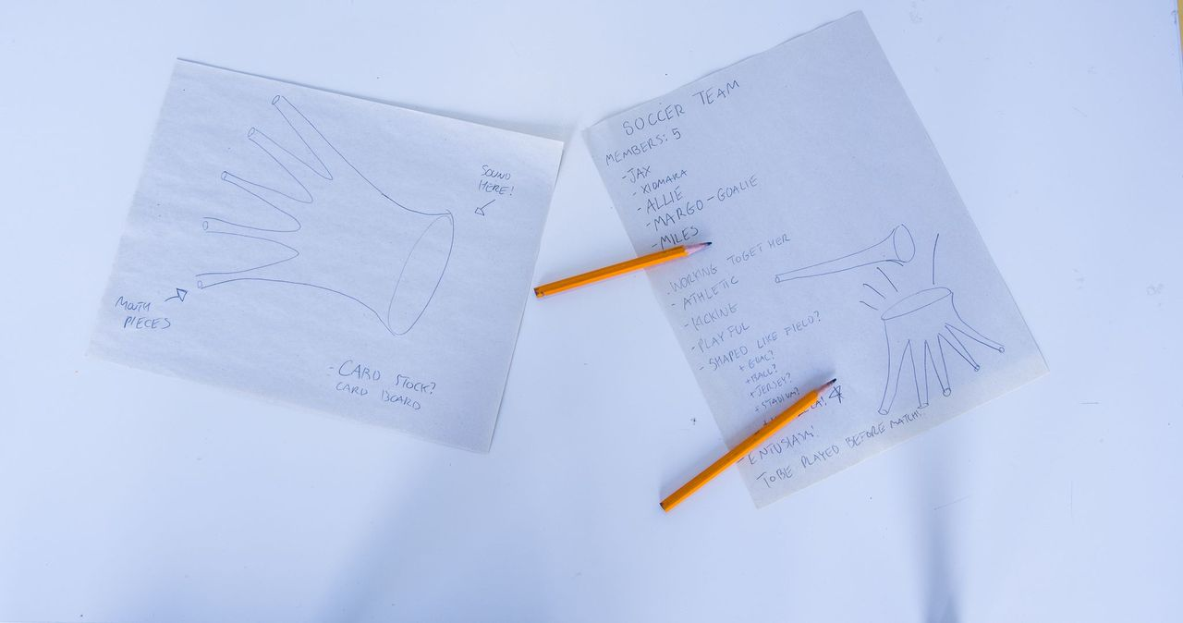
GET LOUD
Paper amplifiers
Invite students to think of a group of people in their lives. This could be a team they are part of, their family, their friends, a fan base... Ask them to consider what matters to this group, what kinds of needs they have, what symbols they are represented by?
Next, imagine an instrument that is meant to be played as a group. That group of people in your life: Who are they? What are their needs? What matters to them? Invent an instrument that could be played by them. What would it sound like? When will you play it? How?

Slide 43
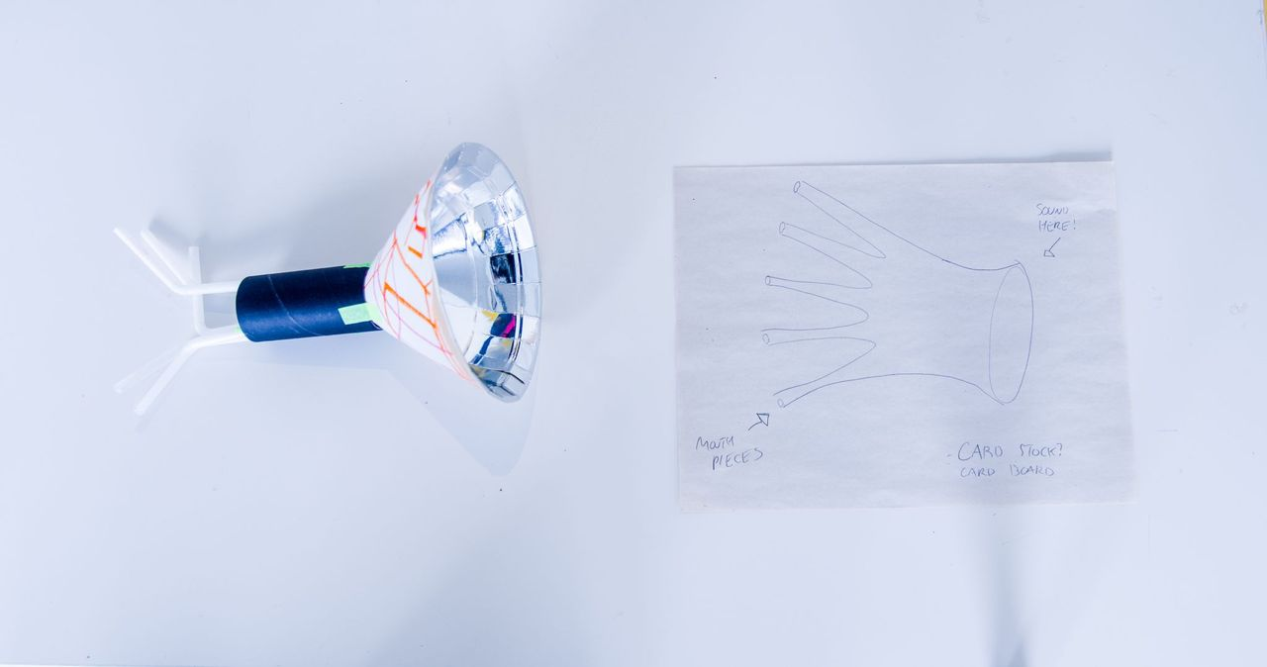
GET LOUD
Paper amplifiers
Once students have sketched their instruments, invite them to construct a sculptural sketch of the instrument. Start by creating the shape of the instrument out of cardboard or recycled materials. Then add the instrumental components by crafting “strings” with rubber bands, or flutes with straws.

Slide 44
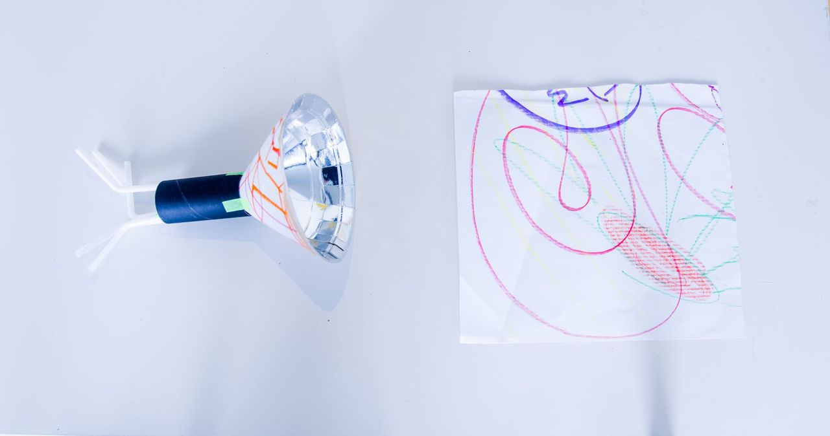
GET LOUD
Paper amplifiers
Ask students to adorn and decorate their sculptures with the decorative paper made in Lesson Block 1 and symbols or illustrations that relate to the group their instrument is for.

Slide 45
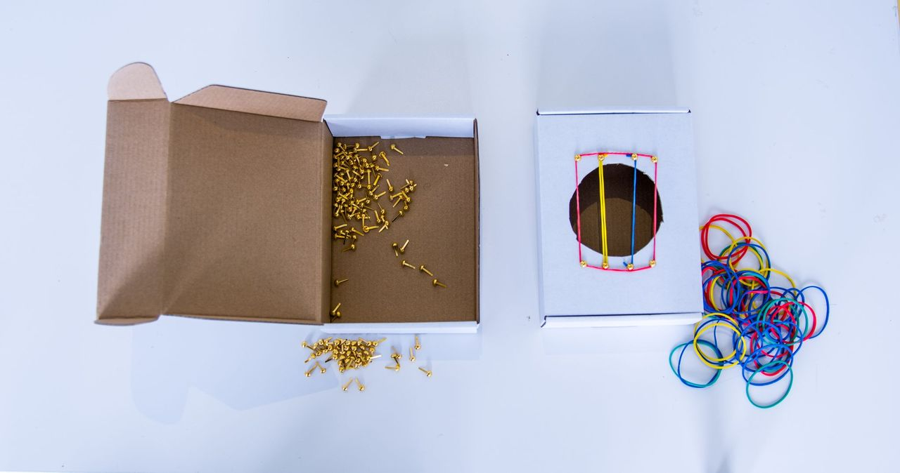
GET LOUD
Paper amplifiers
To create a playable instrument, consider the different kinds of sounds instruments make and how they could recreate them. Here are a few starting points but encourage exploration of the materials.

Slide 46
GATHERING

Slide 47
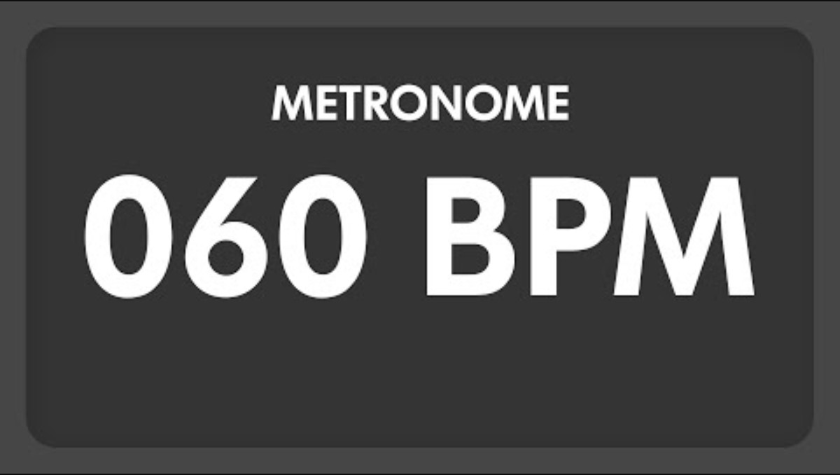
Clap along on the downbeat.
60 BPM Metronome

Slide 48
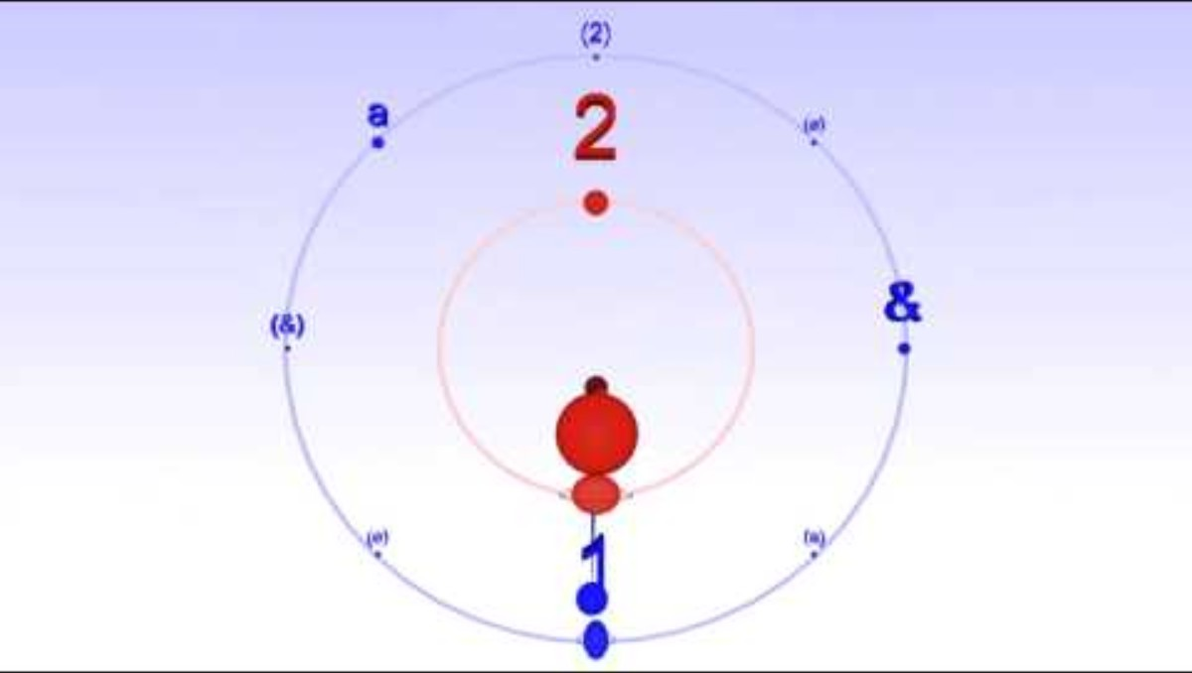
Clap along to the Tresillo pattern.
Tresillo pattern over Two

Slide 49
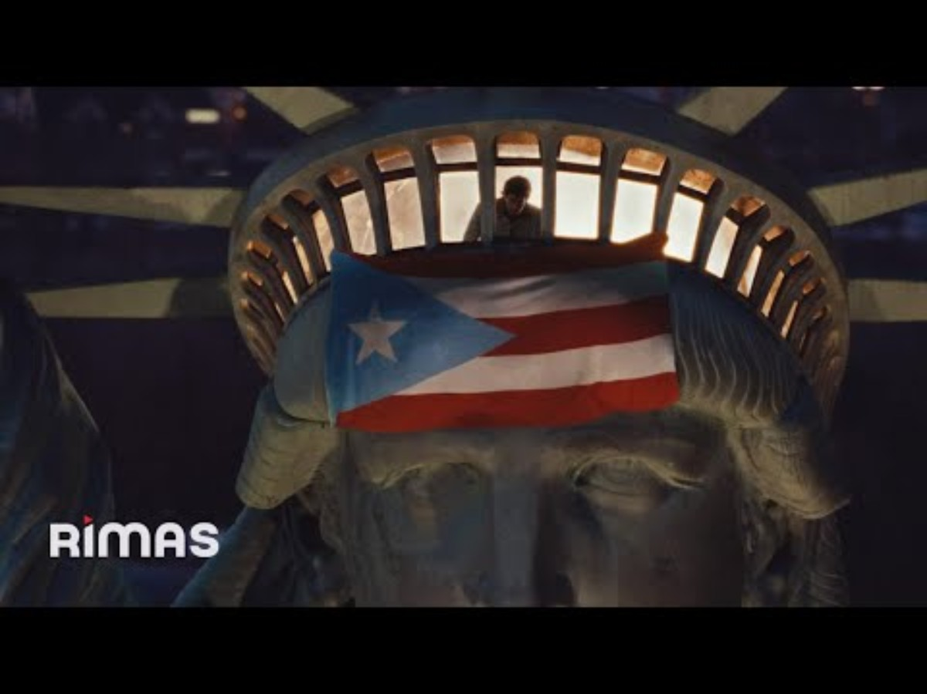
Clap the Tresillo pattern along to a song!
BAD BUNNY
NUEVAYoL, 2026

Slide 50
INTERLUDE
FROM UNDER MI SLENG TENG TO DEMBOW

Slide 51
LISTENING
Subtitle goes here if you need it

Slide 52
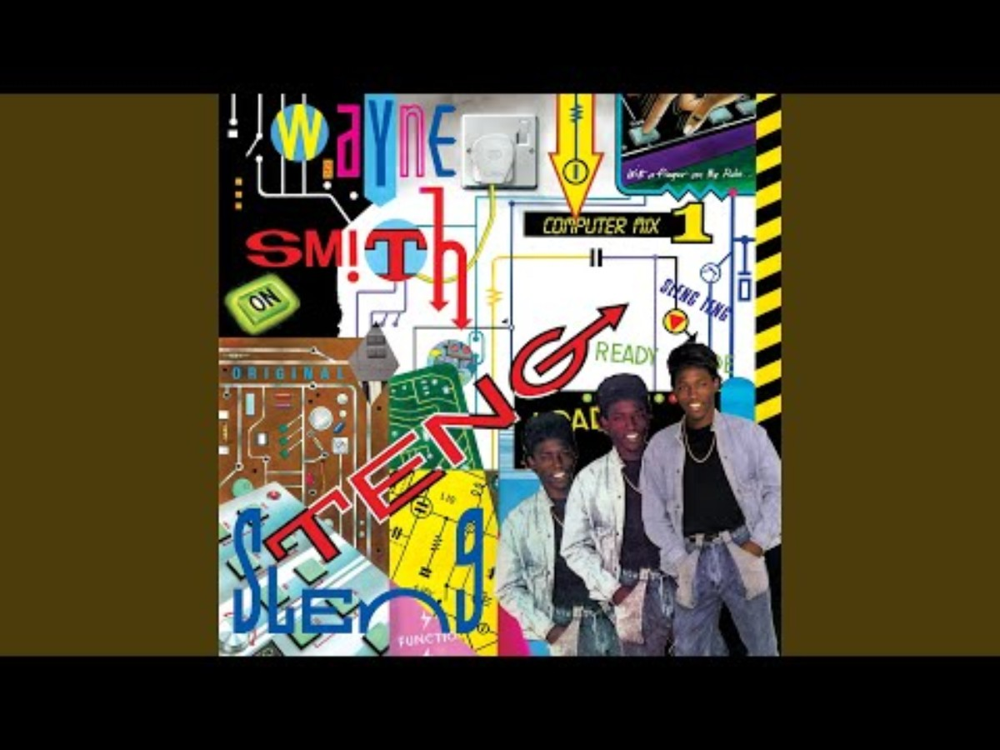
Under Mi Sleng Teng
Under Mi Sleng Teng
by Wayne Smith, Noel Davey, and Lloyd “King Jammy” James
Jammy’s/Greensleeves, 1985

Slide 53
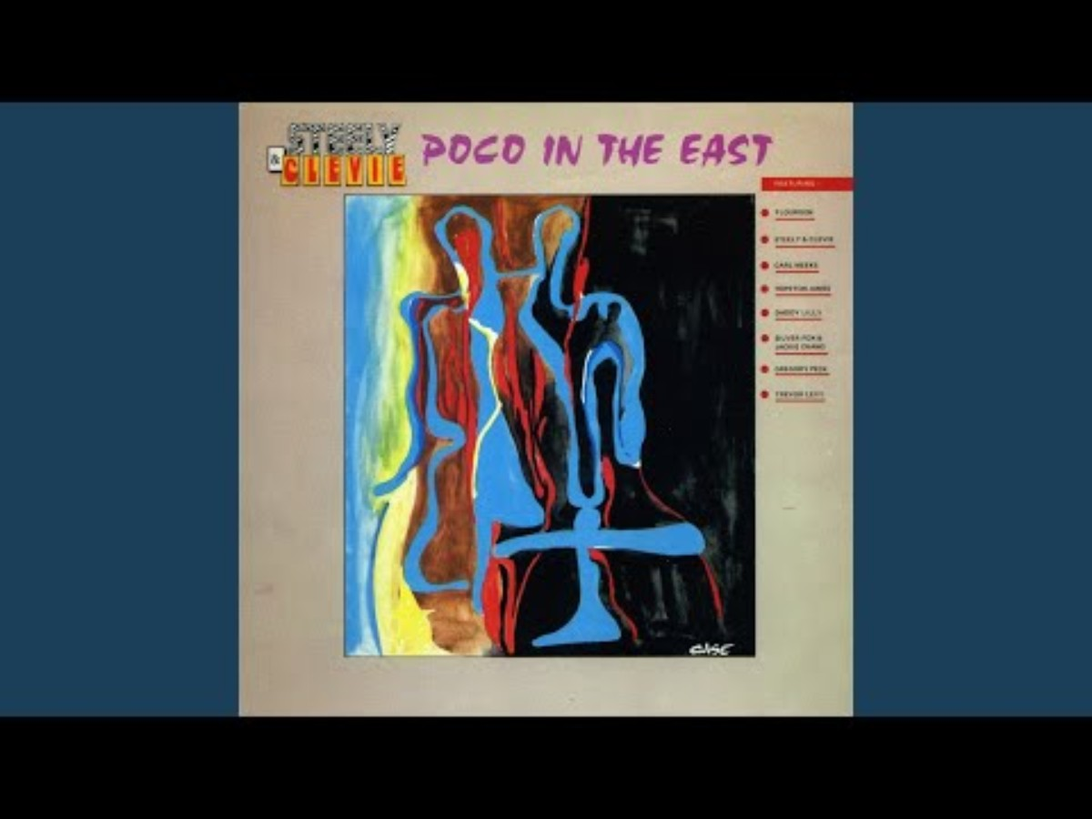
Fish Market
Fish Market
By Steely & Clevie
VP Records, 1990

Slide 54
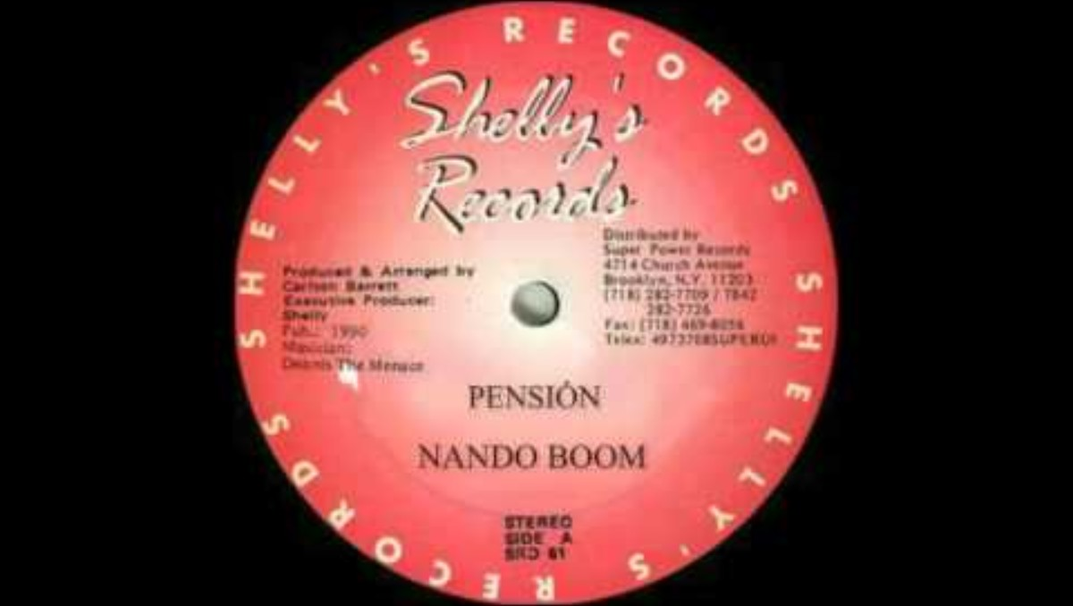
Pensión
Pensión
By Nando Boom
Dennis the Menace, 1990

Slide 55
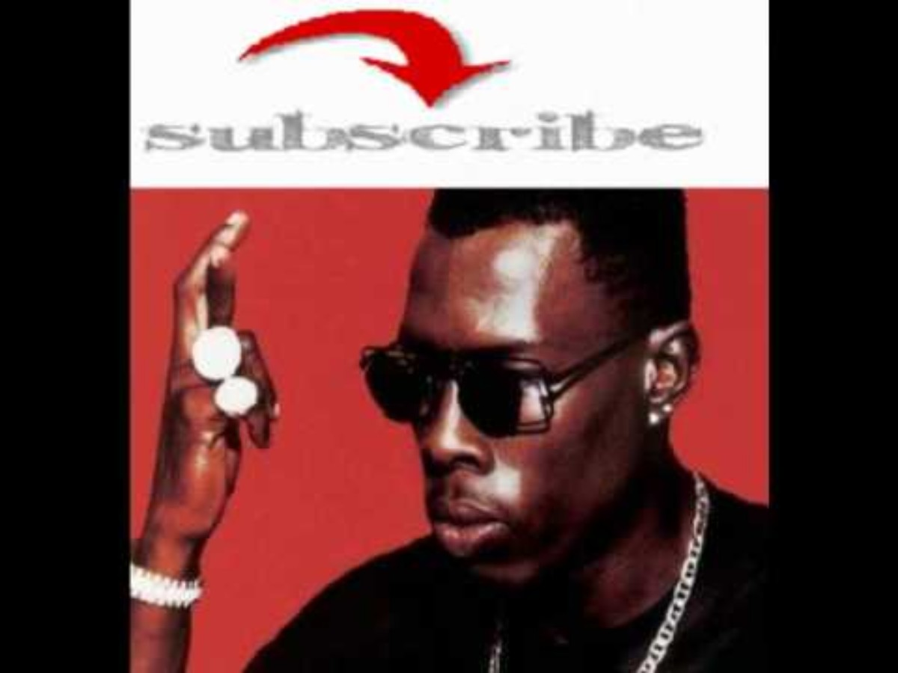
Dem Bow
Dem Bow
By Shabba Ranks
Bobby Digital, 1990

Slide 56
LESSON BLOCK 3
SLACKNESS

Slide 57
LISTENING
Subtitle goes here if you need it

Slide 58
Talk of a time you were at a celebration, how did you show up? Who was there? Did it inform how you dressed, talked acted?
Was there a time when you felt excluded or like you didn’t fit in? How about a time you fit in?
What makes you feel most like yourself? When do you feel free?

Slide 59
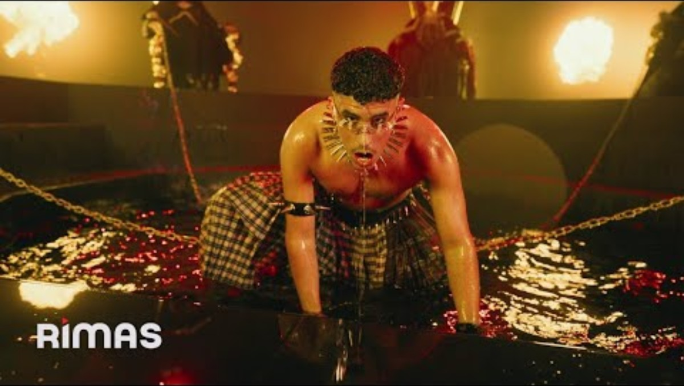
Listen and reflect on the questions on the next slide.
Yo Perreo Sola
By Bad Bunny and Cita
Bad Bunny and Tainy, 2020

Slide 60
Does this sound familiar to anyone? Even if you don’t recognize the song, does rhythm or texture remind you of something you do know?
When do you think a song like this might play?

Slide 61
Bad Bunny’s song “Yo Perreo Sola” (“I Twerk Alone”) is about independence and respect for women. The song speaks out against sexual harassment and supports a woman’s right to enjoy herself at a club without being bothered. Written from a female point of view with singer Nesi, the song explains that a woman can choose to dance alone and should not receive unwanted attention. This message is made even stronger in the music video, where Bad Bunny dresses in drag to show how uncomfortable unwanted attention can be. The video ends with a clear message: if a woman does not want to dance with you, you should respect her choice.

Slide 62
What are other songs that share similar messages?
How is Bad Bunny using his platform? Do celebrities have a responsibility to use their platforms for good?
Has a song or a piece of media ever changed your perspective on something?
What role does art and music play in creating cultural change?

Slide 63
LOOKING
Subtitle goes here if you need it

Slide 64
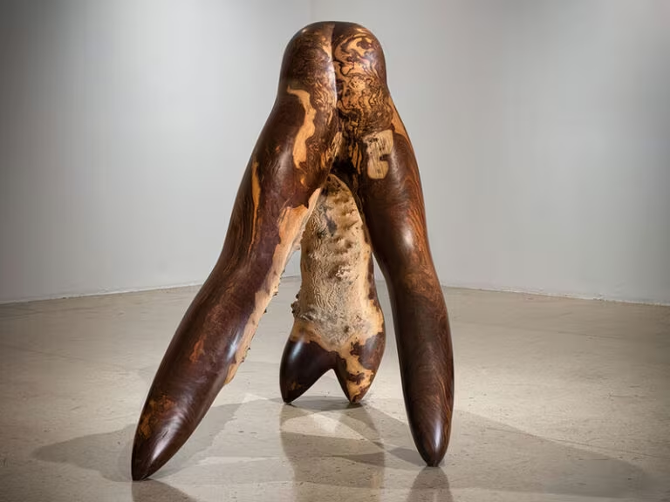
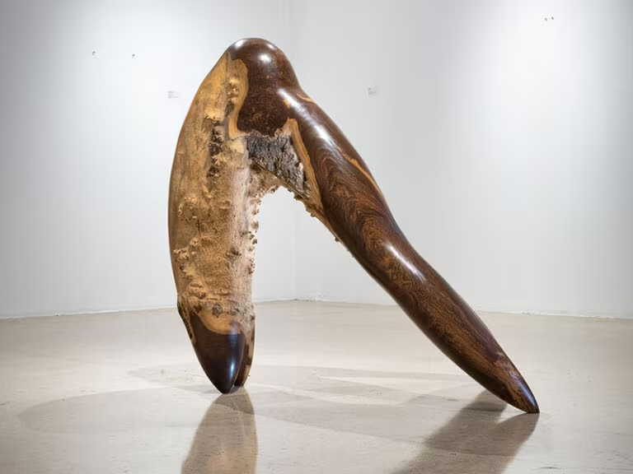
Laura Facey, Divine, 2018
Laura Facey (b. 1959, Kingston, Jamaica; lives in Kingston, Jamaica)
Divine, 2018
Lignum vitae wood
Courtesy of the artist

Slide 65
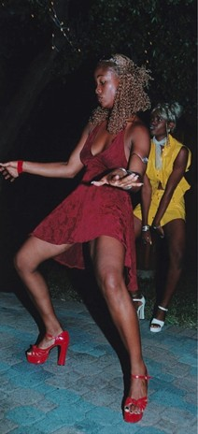
Adrian Boot, Dancehall Queens, 2002
Adrian Boot (b. 1947, Location, Location; lives in Dorset, United Kingdom)
Dancehall Queens, 2002
Silver and photographic gelatin on photographic paper
Courtesy of the artist

Slide 66
Why do you think the people in the photo are dressed that way? Have you ever picked out a special outfit for an event? What was it? How did it feel to be dressed up?
Have you ever been forced to wear something? How did it feel? Was there ever a time when you felt like you had to change something about yourself to fit in or feel comfortable? What was that like? What did you feel like you had to change?
Have you ever worn something to celebrate your individuality or identity? What did you wear, how did you feel?
How do both these different artworks challenge and contradict expectations? How does it make us feel to see a norm challenged? Does anything change about how you see the norm?
What feeling or attitude do these artworks convey to you?
How does the photograph capture an aesthetics (fashion, pose, style) and confidence?
How do the different materials—photography versus sculpture—affect how you perceive the movement and the body?

Slide 67
The emergence of the Dancehall Queen in 1980s Jamaica coincided with a period when dancehall music was often characterized as violent, vulgar, and misogynistic, frequently featuring sexually explicit and homophobic lyrics. Despite this context, the Dancehall Queen became an important figure in the scene.
The Dancehall Queen is a femme performer who is judged and crowned in competitive events based on her unique dance moves, fashion, and stage presence. These women are often described as being sexy, desirable, erotic, and very empowered, with an understanding of their own sexuality.
Dancehall Queens assert their identity through fashion, wearing clothing that was considered very revealing at the time, showcasing their bodies. They often wear custom-made designs created by local dressmakers and tailors. Their attire is typically eye-catching, reflecting a “ghetto fabulous” aesthetic that manifests lower-class prosperity. They often wear blonde or red wigs and use extravagant designs to creatively register feelings of anxiety, vulnerability, and joy.
The moves performed by Dancehall Queens, such as the Butterfly dance credited to original Dancehall Queen Carlene, center on hip movements, continuing a centuries-long Black Atlantic performance tradition related to fertility rituals. The use of twerking or “wining” (rotating hips) in the dancehall is linked to the historical imperative for African peoples to perform as a requirement for life and survival.
Decoloniality focuses on dismantling power structures and biases (race, class, gender) that persist after the end of political colonization. In this context, using explicit sexuality and defining one’s own beauty and status is a direct rejection of polite respectability and Eurocentric ideals that are embedded within colonial society.

Slide 68
How does the expression of Slackness—defined by openly sexual expression, provocative fashion, and defiant attitude—function as a political act?
In what ways do these two artworks intentionally violate conventional expectations regarding how the female body should be publicly presented?
Dancehall dance focuses on hip movements, continuing a centuries-long tradition linked to fertility rituals. How does knowing this history change your perspective on the artworks? Do you have any new associations?
How do the decisions made by the Dancehall Queens about fashion, body size, and demeanor (e.g., larger-bodied women defining themselves as beautiful) become an explicit act of subversion against the moral and class-based standards inherited from colonial frameworks?

Slide 69
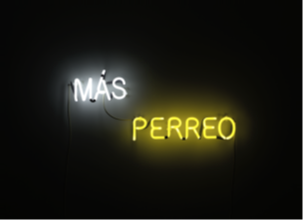
Bobby Cruz Lopez, Más Perreo, 2015
Bobby Cruz Lopez (b. 1984, San Juan, Puerto Rico; lives in San Juan, Puerto Rico)
Más Perreo, 2015
Neon
Courtesy of Private Collection

Slide 70
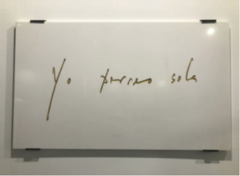
Dagoberto Rodríguez, Yo Perreo Sola, 2021
Dagoberto Rodríguez (b. 1969, Caibarién, Cuba; lives in Madrid, Spain)
Yo Perreo Sola, 2021
material
Courtesy of the artist

Slide 71
What do the two phrases, "Yo perreo sola" (I dance perreo alone) and "Más Perreo" (More Perreo), suggest about the context and meaning of this dance?
How do the materials influence how you perceive the importance or respectability of the message?

Slide 72
Definition: Perreo is a Reggaetón dance style named after the Spanish word for dog, involving seductive front-to-back hip movements. It’s similar to twerking with a partner.
The dance has a history of being criminalized. In the early 2000s, Reggaetón and perreo were at the center of a campaign which sought to ban the dance. The dance was labeled as “vulgar” and associated with “sexual acts between dogs.”

Slide 73
Can you think of a piece of slang, fashion, or music from your own life or community that is often dismissed or called “low-class,” but which you believe holds cultural value or dignity?
If the concept of perreo is about the freedom of the body to move and express itself, can you name a specific song, dance style, or gathering space (public or online) where you or your friends feel completely free to be yourselves, regardless of what mainstream society thinks? What elements (like the music, the style of dress, or the group around you) in that space make you feel visible, empowered, or liberated?

Slide 74
MAKING

Slide 75

BODIES DANCILY
DANCE PHRASES

Slide 76
GATHERING

Slide 77

STEADY, CAPABLE, SURE, CONFIDENCE MEDITATION
Music for Meditation

Slide 78
LESSON BLOCK 4
PROTEST

Slide 79
LISTENING
Subtitle goes here if you need it

Slide 80
What was a time you took a stand?
What were you standing up for?
Who was there with you?
Where was it?
How did you do it?
How did it feel?

Slide 81
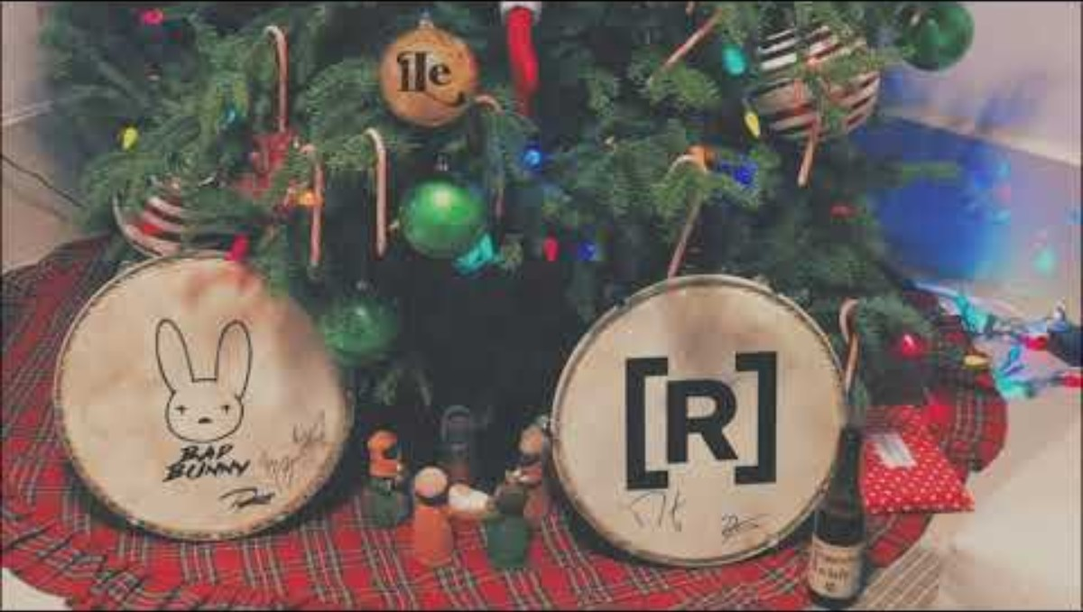
Listen and reflect on the questions on the next slide.
Affilando los Cuchillos
By Bad Bunny, Residente, and iLe
Residents de calle, 2019

Slide 82
Do you notice any ways the evocative title “sharpening the knives” show up musically in this track?
What musical elements help to emphasize the defiant aspects of the message?

Slide 83

Share this short segment about the track to provide more context.
Contreras, Felix. “A Puerto Rico Protest Song: ‘Afilando Los Cuchillos.’” NPR, 28 July 2019

Slide 84
The song was entirely written, recorded, and released for free on YouTube within 24 hours. How does the ability to create and distribute a powerful political message almost instantly change the relationship between artists, protest movements, and traditional media like radio or news outlets?
What unique power do major celebrity artists bring to a local political protest? Why might their public involvement legitimize or amplify the struggle to a global audience? Are there any downsides?
Why would artists choose to risk alienating conservative listeners by using offensive language to denounce a politician?

Slide 85
LOOKING
Subtitle goes here if you need it

Slide 86
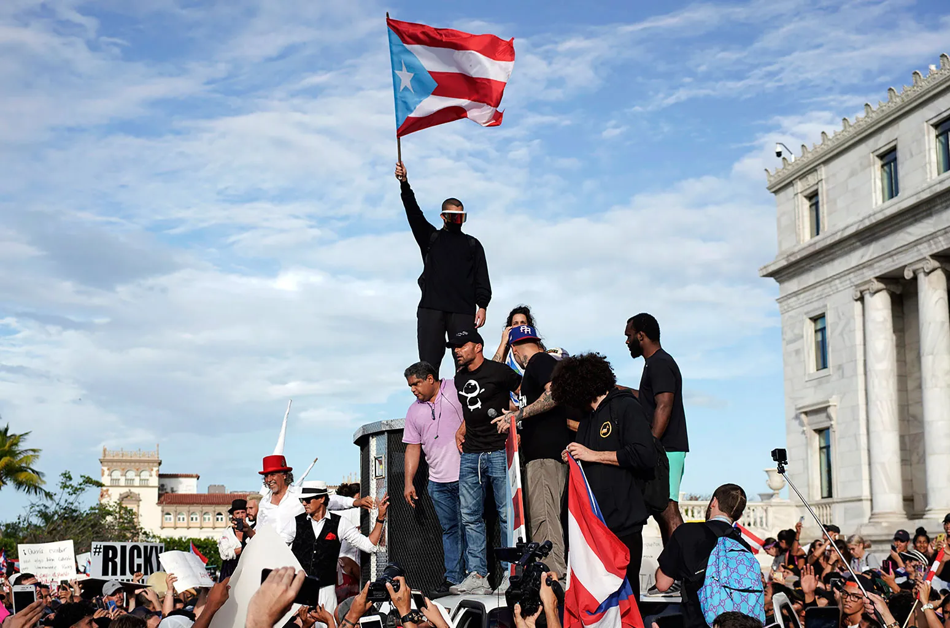
Eric Rojas, Ricky Martin (C), Puerto Rican rapper René Pérez, aka Residente, (R), Puerto Rican reggaetón singer Bad Bunny (T), take part of a demonstration demanding Governor Ricardo Rosselló's resignation in San Juan, Puerto Rico on July 17, 2019.
Eric Rojas (b. 1988, San Juan, Puerto Rico; lives in San Juan, Puerto Rico)
Ricky Martin (C), Puerto Rican rapper René Pérez, aka Residente, (R), Puerto Rican reggaetón singer Bad Bunny (T), take part of a demonstration demanding Governor Ricardo Rosselló's resignation in San Juan, Puerto Rico on July 17, 2019.
Digital Photograph
Courtesy of the artist

Slide 87
What kind of event is this? How can you tell?
What is the energy of the protest?
Can you read any of the signs? What do you think they are protesting?
Who are the people in this image? Can you make any of them out?
The person holding the flag is the musician Benito Antonio Martínez Ocasio better known as Bad Bunny. What do you already know about him?
Have you ever seen images of celebrities at protests? What did it make you feel?
Does this image remind you of any other images you have seen before?

Slide 88
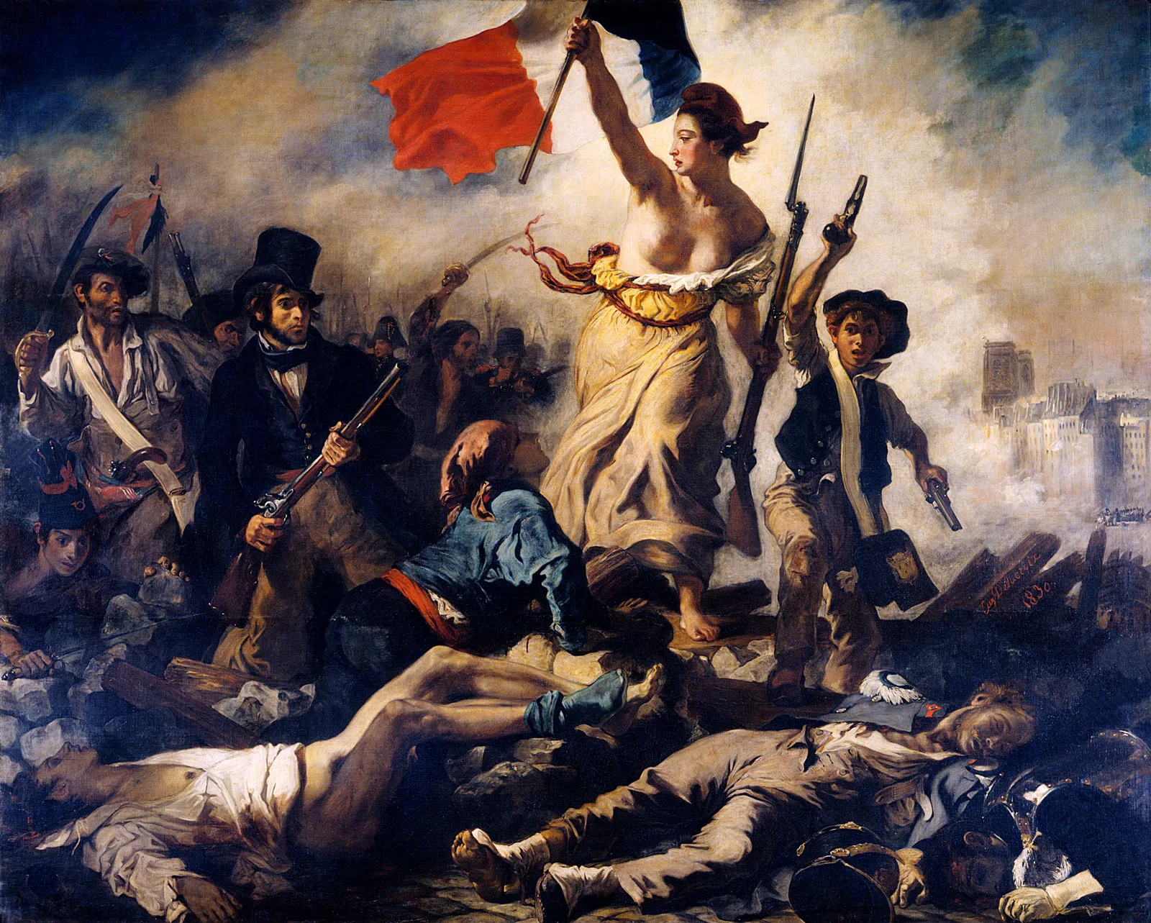
Eugène Delacroix, Liberty Leading the People, 1830
Delacroix, Eugène
Liberty Leading the People. 1830. Oil on canvas
Louvre Museum

Slide 89
What similarities do you see with this image? What do you think these people are protesting? How does it look different?
How do we encounter images from protests or other political movements? What do the images look like? Where do you find them? Why do we take pictures? What role do images play in political movements?
Delacroix’s painting is centered on the allegorical figure of Liberty, a nude-to-the-waist personification of the idea of freedom. Rojas’s photograph features the musician Bad Bunny at the peak of the crowd. Both figures occupy the visual peak of the composition. What do these different people suggest about how we should understand revolution in the 21st century?
Delacroix’s Liberty wears the Phrygian cap, a classical signifier of freedom given to freed slaves in ancient Rome. In Rojas's image, Bad Bunny wears Nopeet shield glasses and a face mask. What do these contemporary symbols—often associated with style, privacy, or self-protection—suggest about the nature of political protest and visibility in the age of digital media and government surveillance?

Slide 90
Both central figures hold the national flag. Liberty raises the French tricolor, while Bad Bunny holds the Puerto Rican flag. Residente commented that during the Verano del ‘19, Puerto Ricans of opposite political persuasions stood behind the country's flag as a symbol of unity.
How does the act of holding the national flag function as a symbol of unity and a rejection of corruption in that nation?
Delacroix intentionally included figures of all social classes—a worker in an apron, a middle-class man in the top hat, and a schoolboy—to suggest that the revolution was for everyone. The Verano del ‘19 protests were similarly inclusive.
What are the visible signs in the Rojas photograph (clothing, accessories, position in the crowd) that suggest this protest unified people from diverse social classes, sexualities, and communities?
Delacroix’s protesters carry military weapons (a bayonetted musket, pistols) used for conflict on barricades. In the Puerto Rican protests, dance and music became acts of resistance.
-What are the non-traditional instruments of dissent pictured in Rojas photograph?

Slide 91
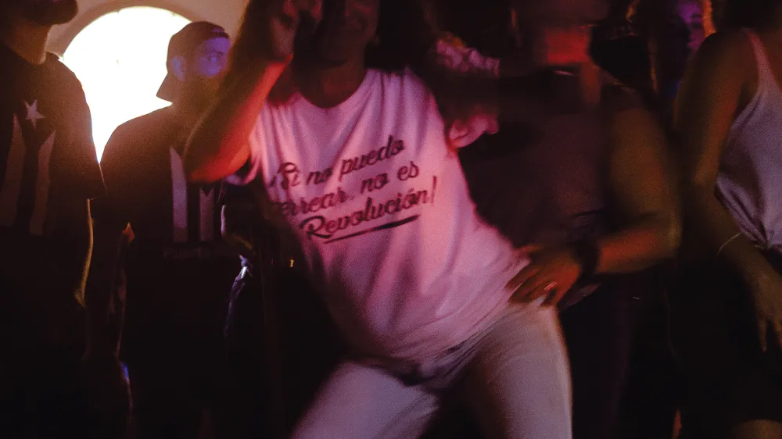
Supakid, Untitled (Ricky Renuncia), 2019
Untitled (Ricky Renuncia), 2019
Supakid (b. 1985, Bayamón, Puerto Rico; lives in San Juan, Puerto Rico)
Digital Photograph
Courtesy of the artist

Slide 92
What does the message on the T-shirt suggest about the relationship between dancing and revolution? (“If I can’t dance perreo, it’s not my revolution.”)
Why might dancing, an activity often associated with fun or entertainment, be considered a form of political protest in this context?
How does the woman's pose, attitude, or style suggest defiance?

Slide 93
This photograph documents the Perreo party or Combative Twerking (Perreo Combativo) event that took place in San Juan during the protests to demand the resignation of Governor Ricardo Rosselló.
The slogan on the t-shirt reflects the central strategy of Perreo Combativo: using expressive dance—specifically the Reggaetón dance style known as perreo—as a political tool against an oppressive government that had demonstrated misogynistic and homophobic disregard for its people.
Perreo involves seductive front-to-back hip movements, similar to twerking, and the dance is traditionally categorized as “vulgar.”
The Perreo Combativo event was convened by queer individuals (LGBTQ+ and gender non-conforming youth) and allies. It famously occurred on the steps of the central church of the capital, San Juan’s Cathedral. By performing this explicit, sexualized dance in a sacred and traditional space, the protesters were intentionally disrupting heteropatriarchal system and the norms that had historically condemned their sexual freedom.
The dance was a way of “putting the body” (poner el cuerpo) forward, asserting the “erotic body as a political instrument of dissent.” For non-white, femme, and queer individuals, this act becomes a means to alter culture and an act of decolonial joy.

Slide 94
The message on the T-shirt captures the idea that liberation must include the right to uninhibited, expressive movement and the freedom to celebrate one’s identity and sexuality, even through practices considered “vulgar” by some.
The protests were sparked partly by leaked chats where the governor and his allies used misogynistic and homophobic slurs.
How does the decision to use a sexually explicit dance as a weapon of protest turn the tables on those who tried to control and condemn the people’s bodies and behavior?
The sign says, “If I can't dance perreo, it's not my revolution.” What does this phrase suggest about the difference between a political revolution fought only with traditional speeches and laws versus one fought through culture, joy, and physical expression?

Slide 95
MAKING

Slide 96
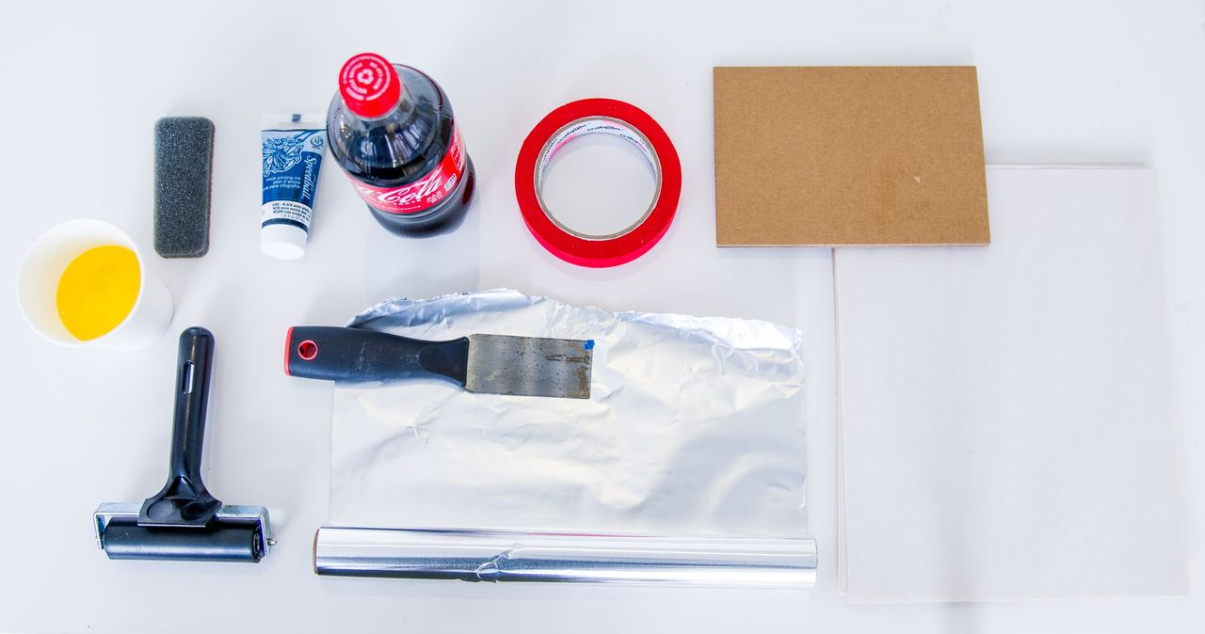
SWEATY PALMS
Printmaking with the body
Gather materials: Aluminum foil, Smooth card, Masking tape, Newsprint, Cotton rags, Cola, Vegetable oil, Clean Sponge, Roller, Glass for inking, Oil based printing ink, Paper for printing, and a Wooden spoon.

Slide 97
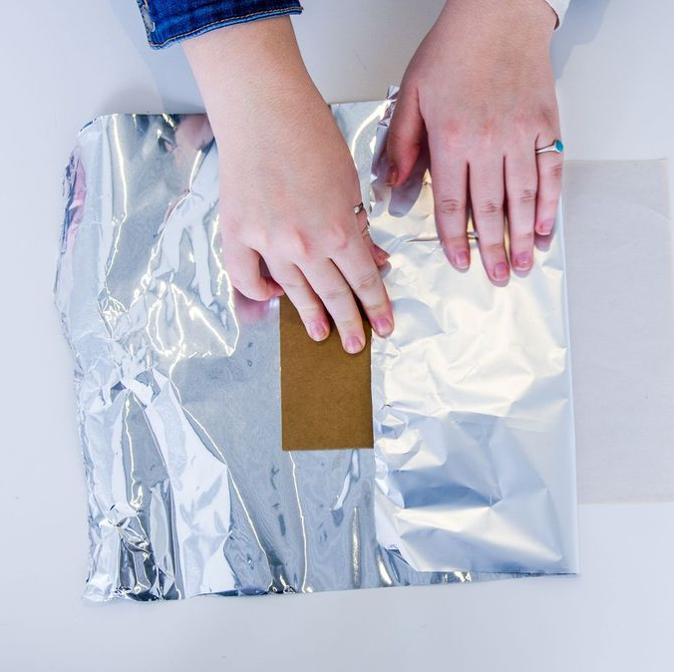
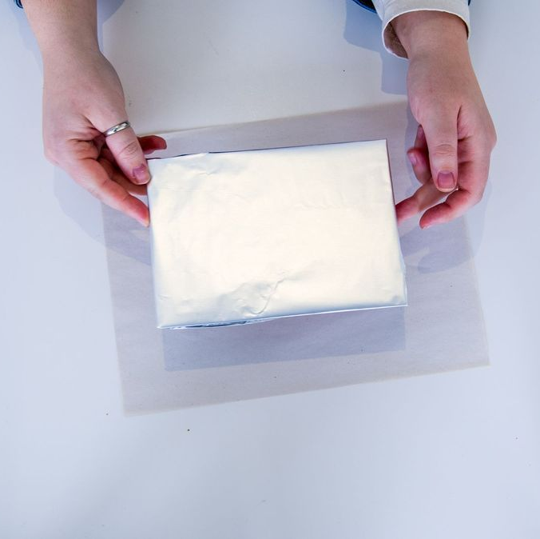
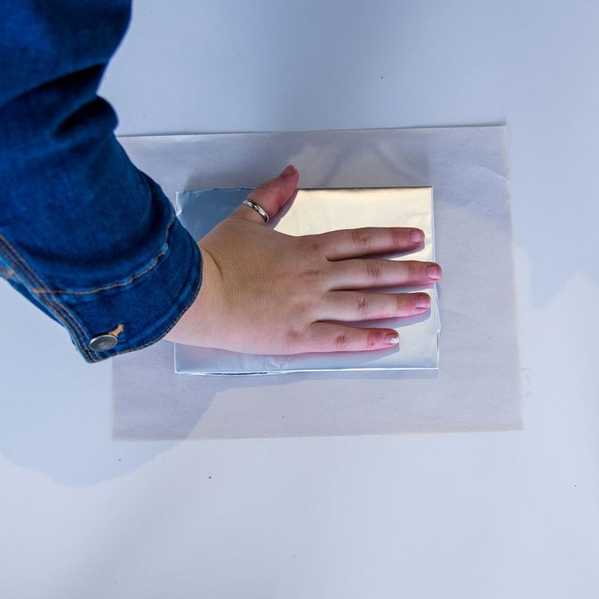
SWEATY PALMS
Printmaking with the body
To prepare the plate, tear off a sheet of tin foil and place it shiny side up on a very clean sheet of paper. Place a piece of mount board or an old etching plate in the center, then fold the foil edges over the board to form the back of the plate and tape them securely.
Carefully turn the plate over, making sure not to touch the front (the matte side).
After all materials are prepared, invite students to have a short dance party. Play some of their favorite songs and encourage them to dance for five to ten minutes. Afterwards, have students press a part of their body with visible skin onto the prepared plate. Any area that contains natural oils will appear in the final print.

Slide 98
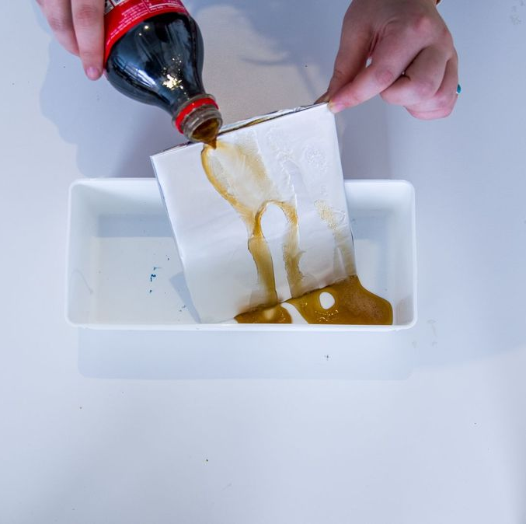
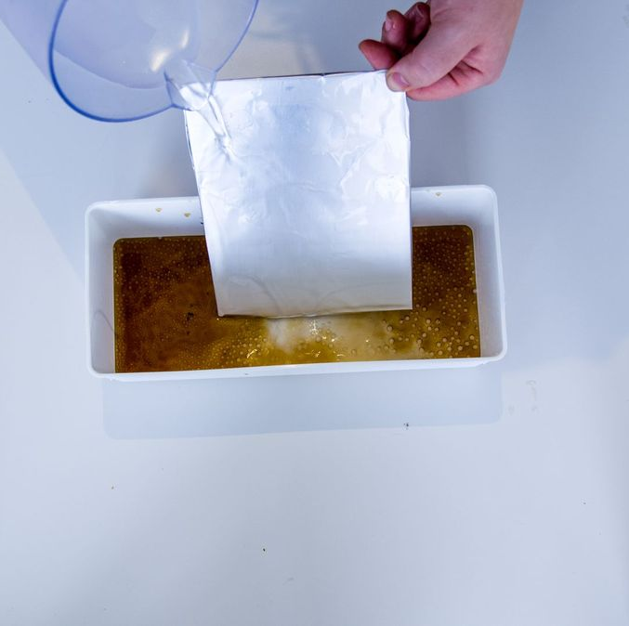
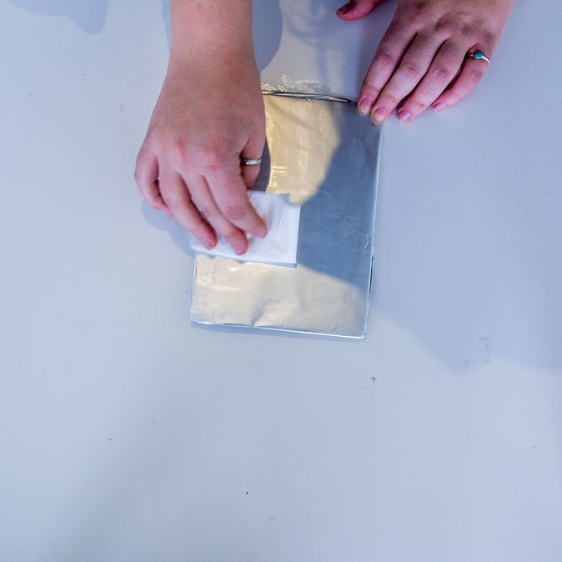
SWEATY PALMS
Printmaking with the body
When you are satisfied with the image, pour cola over the plate from both directions over a sink or container. The cola can be reused for other plates.
Rinse the plate with water to remove the cola.
Gently clean the plate with a rag and a small amount of vegetable oil.

Slide 99
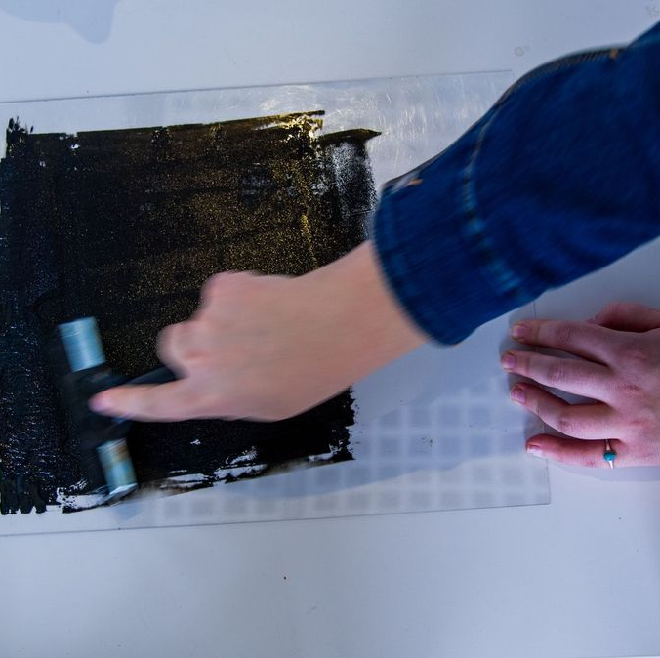


SWEATY PALMS
Printmaking with the body
Roll out some oil-based printing ink.
Lightly dampen the plate with a clean sponge and clean water (not too wet), then roll on a thin layer of ink. The roller should be quiet, not “hissing.”
Damp the plate again and roll another thin layer of ink. Repeat until a visible ink film appears on the surface. If the white areas begin to fill with ink, wipe them with a small amount of cola. This can occur due to over-inking, the plate drying out during inking, or overly alkaline sponge water.

Slide 100



SWEATY PALMS
Printmaking with the body
Give the plate a final gentle wipe with the damp sponge, then place it side up.
Carefully position the printing paper on top of the plate and cover with newsprint (or greaseproof paper if printing by hand).
Print by rubbing a spoon or hand over the plate.

Slide 101

SWEATY PALMS
Printmaking with the body
To make additional prints, repeat the inking and wiping process. If handled carefully and the foil remains intact, many prints can be pulled from a single plate.

Slide 102
GATHERING

Slide 103

TAKE IT OUTSIDE
WHEATPASTING MESSAGES
Gather materials: Flour, Water, Small pot, Whisk or spoon, Container with a lid, Brush or sponge, Paper or artwork printed on thinner paper, and a Clean surface

Slide 104



TAKE IT OUTSIDE
WHEATPASTING MESSAGES
Next, to make the paste: In a pot, whisk 1 part flour with 2–3 parts water until smooth. Heat the mixture on medium, stirring constantly, until it thickens to the texture of thin pudding. Remove from heat, add a pinch of salt if desired, and let it cool.
Decorate the artwork you would like to wheatpasted use lightweight paper and make sure the surface you’re pasting to is clean, and dry.
Apply the base layer: Use your brush or sponge to spread a thin, even coat of wheat paste onto the surface.

Slide 105

TAKE IT OUTSIDE
WHEATPASTING MESSAGES
Carefully press your paper onto the pasted area, starting in the center and smoothing outward to remove air bubbles.
Brush another thin layer of wheat paste over the top of the paper, making sure the edges are fully coated and smoothed down.
Leave the piece undisturbed until it dries completely; the paste will turn clear as it dries.

